Slide 1
What is the ELEVATED EXPRESS WAY?
Phase – I - LIGHT HOUSE – ELLIOT’S BEACH (4.7 km)
GANDHI STATUE to FORESHORE ESTATE (2.4 km) & FORESHORE ESTATE to ELLIOT’s BEACH (2.3 km)
Phase – II – ELLIOT’s BEACH to EAST COAST ROAD (5 km)

Slide 2
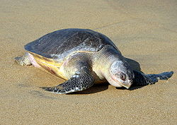
Construction of the EXPRESSWAY would disrupt the nesting spots of Olive Ridley Turtles.

Slide 3
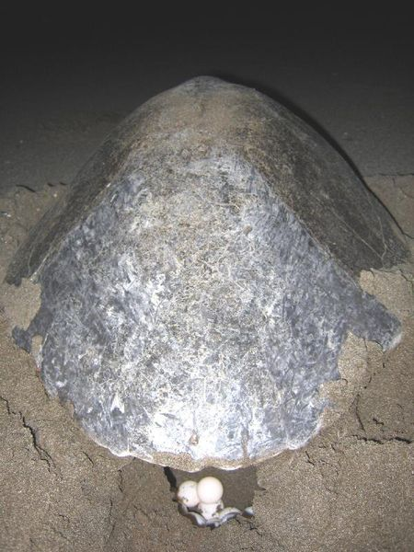
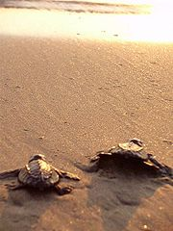
Olive Ridley Sea Turtle laying eggs Olive Ridley Sea Turtle Hatchlings moving towards water

Slide 4
Impact
FISHERFOLK
It is likely to affect adversely their livelihood.
ENVIRONMENT
LOCAL POPULATION
Residents of Foreshore Estate, Olcott Kuppam & Orur Kuppam

Slide 5
Project Status Wilbur Smith Associates submitted the Final Feasibility Study of the Corridor. Environmental Activists have submitted their protests. Wildlife Activists have pointed out that the Project will make 30 year old conservation program of the critically endangered Olive Ridley Turtles, useless. Recent Newspaper Reports suggest that the Government may adopt a different alignment for the Light House to Besant Nagar stretch. No clarity on Elliot’s Beach to Kottivakkam stretch.

Slide 6
Cost of the Project & its rationale?! Rs.1000 Crores Reason : To decongest peak hour traffic According to the Government, at least 900 new vehicles hit the City’s Roads.

Slide 7
What does the Report of Wilbur Smith state? The Feasibility Report states that the first phase of the proposed road project will affect 529 houses, the commercial buildings and three religious buildings. will also impact the environmentally sensitive Adyar Estuary and Olive Turtle Breeding Grounds along the Corridor.

Slide 8
Legal Provisions Constitution of India Art.48A: The State shall endeavour to protect and improve the environment and to safeguard the forests and wild life of the country. ARTICLE 48A deals with ‘Environment, Forests and Wildlife’. These three subjects have been dealt with in one article for the simple reason that the three are interrelated. Protection and improvement of environment is necessary for safeguarding Forests and Wildlife, which in turn protect and improve the Environment. Forests and Wildlife are clearly interrelated and interdependent. They protect each other. Art.51A: It shall be the duty of every citizen of India, inter alia, to protect and improve the national environment including forests, lakes, rivers, wildlife and to have compassion for living creatures. These two articles are not only fundamental in the governance of the country but also it shall be the duty of the State to apply these principles in making laws and further these two articles are to be kept in mind in understanding the scope and purport of the fundamental rights guaranteed by the Constitution including Arts. 14, 19 and 21 and also the various laws enacted by Parliament and the State Legislatures.

Slide 9
The Environment (Protection) Act, 1986 NOTIFICATION S.O.114(E) – 19th February 1991. This Notification has been issued under Section 3 (1) and Section 3 (2) (V) of the Environment Protection Act 1986 and Rule 5 (3) (d) of Environment Protection Rules 1986 declaring coastal stretches and Coastal Regulation Zone and Regulating activities in the CRZ.

Slide 10
Regulation of Permissible Activities All other activities except those prohibited will be regulated under Clause 3 (V) The following activities will require environmental clearance from the Ministry of Environment and Forests, Government of India.

Slide 11
(V) All other activities with investment of Rs.5 Crores or more. Provided that activities involving investment of less than Rs.5 Crore shall be regulated by the concerned authorities at the State or Union Territory level in accordance with the provisions of sub-para (2) of Para 6 of Annexure I of the Notification. Category-II (CRZ-II): The areas that have already been developed upto or close to the shoreline. For this purpose, “developed area” is referred to as that area within the municipal limits or in other legally designated urban areas which is already substantially built up and which has been provided with drainage and approach roads and other infrastructural facilities, such as water supply and sewerage mains.

Slide 12
Union of India Vs Member Secretary, CMDA (2006) 4 CTC 460 ”Keeping in view the purpose for which such Act was enacted the expression contained in the Act should be given the widest possible meaning so as to prevent the possibility of environmental degradation. The expression is wide enough to include any activity………………..”

Slide 13
Vellore Citizens Welfare Forum Vs Union of India AIR 1996 SC 2715 (i). Environmental measures by the State Government and statutory authorities must anticipate, prevent and attack the causes of environmental degradation. (ii). Where there are threats of serious and irreversible damage, lack of scientific certainty should not be used for postponing measures to prevent environmental degradation. (iii). The onus of proof is on the actor or the developer/ industrialist to show that his action is environmentally benign.

Slide 14
Olive Ridley Turtle is listed as endangered species by IUCN -Marine Turtle Specialist Group. There has been a 50% reduction in population since the 1960s. The highly migrating behaviour of Olive Ridley makes them shared resources among many nations. Olive Ridley Turtles are protected species under Memorandum of Understanding on the conservation and management of Marine Turtles and their habitats of the Indian Ocean and South East Africa.

Slide 15
Olive Ridley Turtles are listed in Schedule I of the Indian Wildlife (Protection) Act 1972. The Tennesse Valley Authority started the building of Tellico Dam on the Little Tennesse River and was constructing the Dam when an endangered fish species called Snail Darter was found upstream. The Endangered Species Act has been passed after construction had begun. The dam would completely inundate the location where the snail darter was found, resulting in considerable harm to the snail darter. The judgement finding that Petitioner Corporation operation of a virtually completed Federal dam would eradicate an endangered species and that an injunction was the appropriate remedy was affirmed because endangered species were affected and continuing appropriation did not contribute an implied repeal of the statue as if applied to the Project.

Slide 16
Environmental bodies have identified four major reasons for concerns about the extinction of endangered species in India. The reasons are:- a). Loss of species as a biological entity. b). Destabilization of an ecosystem. c). Endangerment of other species. d). Loss of irreplaceable genetic material and associated bio chemicals.

Slide 17
An endangered species is actually a population of an organization that is at risk of becoming extinct because it is either (a) few in number (b) threatened by changing environmental or predation parameters.

Slide 18
N.D.Jayal-Vs-Union of India (2004) 9 scc 362 Loss of Livelihood. Factors to be considered by the state while planning a development proect.

