Slide 1
Energy and Renewable Energy
Current Status
Institutional Mechanism and Governing the Energy Sector
Current Concerns of the Sector
Climate Change and Energy demands
Greening the Energy Sector in the State
Sector specific Action Plan and Budget
Implementation Road Map

Slide 2
Energy and Renewable Energy
Current Status
Sector status and growth
Renewable energy sector accounts to close to 40 percent of the Tamil Nadu Electricity Board’s Grid Capacity.
An average of 55-60 percent of the power requirement of state is purchased
Even with large installation capacity from renewable energy sources the actual energy generated is fairly low.
Thermal generation contributes fairly significantly to the electricity requirement of the state.
Plant load factor of wind farms is between 12.56-22percent
The average deficit power of the state is roughly 6.5 percent or approximately 5000 Million Units per year

Slide 3
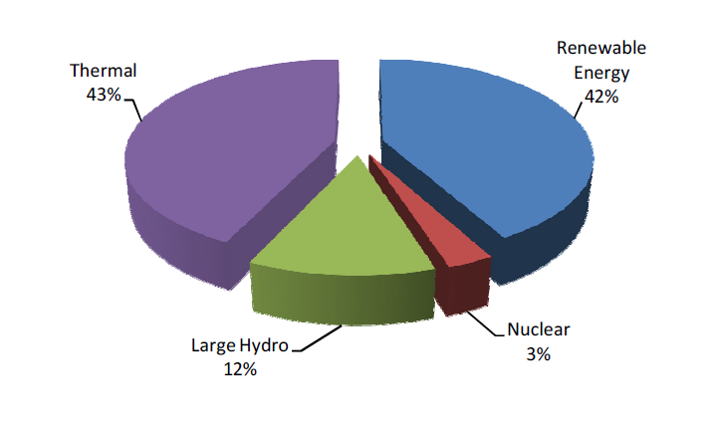

Slide 4
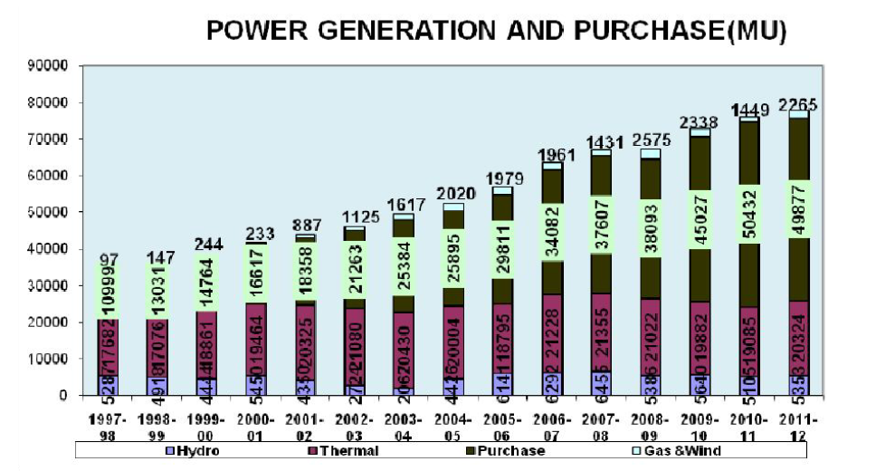

Slide 5
Energy and Renewable Energy
Electricity Consumption Pattern
High electricity consumption of about 1065kWh
Highest number are the domestic consumers
Steady rise in domestic consumption, commercial sector consumption has remained static
Decrease in agricultural sector power consumption
Steady rise in the consumption in the industrial sector
Transmission and Distribution Loss
Loss due to T&D is fairly low. About 18.23 percent.
Addition of 1509 CTK.KM of High Tension Lines in 2008 has also resulted in a drop in the Transmission and distribution losses.
Due to excessive congestion of the Southern Electricity grid the amount of electricity that the grid can transfer cannot be further increased.

Slide 6
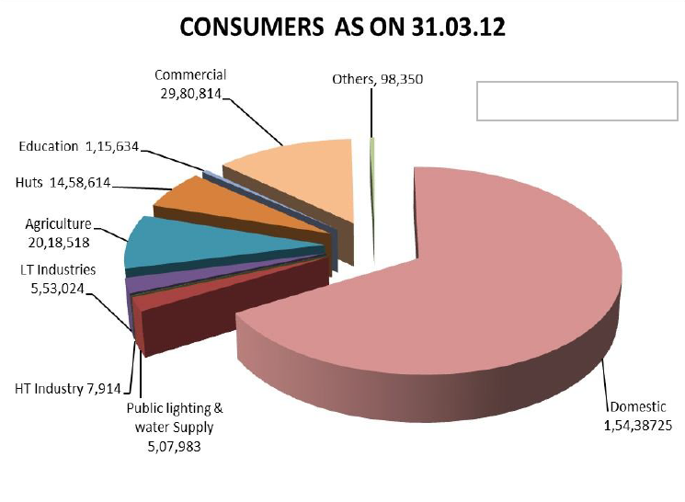

Slide 7
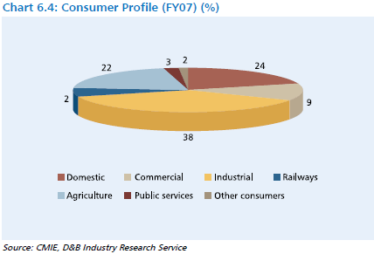
Sector wise Consumption of Energy

Slide 9
Energy and Renewable Energy
Renewable energy trends
Increased renewable energy capacity over the years
34 percent of India’s renewable energy space
Wind energy most successful
Rural Electrification
100 percent rural electrification
Census 2011 state that 93 percent of the total households in the state have access to electricity
Other Electricity usage
2001 census of house hold consumption showed-13 percent use kerosene; 64.3 percent of the household continue to use firewood; 19 percent of the households use CNG.
Expected Projections
Year | Total Electricity demand | Total production for renewable sources
2017 | 55,000MW | 18,000MW
2022 | 70,000MW | 34,000MW

Slide 10
Energy and Renewable Energy
Energy Efficiency and Conservation
Replacement of incandescent bulbs with CFLs / Fluorescent Tube Lights in all Government offices as well as in hutments
All Electrical equipment to comply with BEE efficiency standards
Aiming to promote energy efficient appliances for domestic use
Agricultural sector demand side financing
Other technical committee to adopt and evolve guidelines for building planning authorities
Ensure inter-departmental co ordination and monitoring in various schemes

Slide 11
Energy and Renewable Energy
Institutional Mechanism and Governing the Energy Sector
The Tamil Nadu Electricity Board(TNEB) Ltd. is regulated by the Tamil Nadu Electricity Regulatory Commission (TNERC).
Policies and guidelines for power sector development are framed by the Department of Energy and Government of Tamil Nadu
Electrical safety and energy conservation-Electrical Inspectorate Department, Tamil Nadu
Renewable energy development in the state-Energy Development Agency (TEDA)

Slide 12
Energy and Renewable Energy
Current Concerns of the Sector
Increased level of industrialization hence, need to greater energy supply
Financial implications of tapping renewable energy
Shortage of increased demand
Aggregate Technical and Commercial loss static
Need to implement energy efficiency and conservation
Climate change impacts
Increased demand of energy due to temperature rise
Dependence of farmers on ground water due to scanty and sporadic rainfall
Rapid rate of growth in urban areas increases demand

Slide 13
Energy and Renewable Energy
Climate Change and Energy demands
Energy Consumption and Heat Island Effect - it is estimated that there
would be approximately a 14-15 percent increase in electricity
consumption in the state due to temperature rise, growth of domestic
consumers, increase in consumption due to growth in GDP, increase in
electricity coverage area
Water and hydropower generation- the state is dependent on
Hydropower for electricity production, with science based evidence that
river systems in India could possibly be affected due to Climate Change,
the shortfall in electricity supply could intensify further.

Slide 14
Energy and Renewable Energy
Forests and Fuelwood use-2001 census showed that 64 percent of the total
households in the state were still using firewood as the predominant fuel
for cooking and heating purposes
Irrigation and electricity use- Increased reliance on ground water, due to
lack of surface water, for irrigation purposes has led to rise in demand for
electricity in the agriculture sector

Slide 15
Energy and Renewable Energy
Greening the Energy Sector in the State
Renewable energy development plans
Development of a road map for promotion of solar power generation systems
Integrating biomass based power projects with energy plantations in coordination with the Forest Department
Levying Green Energy cess to fund renewable energy development
Encouraging private public partnership in renewable energy projects and incentivizing renewable energy investments in the state
Enhanced Energy Conservation
Initiating Pilot studies for energy conservation and demand side management improvements and strengthening
Demonstration Projects
Awareness generation and Capacity building

Slide 16
Energy and Renewable Energy
Compliance of Energy Conservation policies in all Government and public buildings of Tamil Nadu
Other areas would include adopting a waste heat recovery policy for the industrial sector
Reducing A T &C losses
To ensure the reduction of A T & C Losses from the current level of 18 percent to 15 percent by 2017 with an attempt to furhter bring it down to 12 percent in the future

Slide 17
Energy and Renewable Energy
Strategies
Minimize AT & C Losses
Undertake efficiency and energy conservation improvements
Launch Green Villages and introduce Energy Efficient Homes Initiative
Drafting new building bye-laws incorporating principles of Energy Conservation and building code
Increasing grid connected RE by 10,650 MW
Encourage Off Grid Renewable Energy development

