Slide 1
Tamil Nadu’s electricity sector Status and Challenges
December 14, 2013
Lawrence Sunderam Hall, Loyola College
Kalpana Dulipsingh | TAMILNADU ELECTRICITY GOVERNANCE INITIATIVE (TEGI)
ILUN YANG | World Resources Institutew

Slide 2
OUTLINE
Some Electricity “Basics”
TN electricity sector – Facts & Gaps
Towards an Integrated Approach in Electricity Planning
Why do we need to concern ourselves with the electricity scenario in TN??

Slide 3
Typical Electrical Power System

Slide 4
Energy vs Power
Energy is referred to as the ability to do work. Energy is measured in units called joules, J. Electrical Energy is measured in watt hrs
1 KwHr = 1 unit of electrical energy = 3.6 MJ
MTOE ?
MTOE = Million Tons of Oil Equivalent
At a thermal plant ,1 MWh is generated with 0.22 TOE fuel (with 39% thermal to electrical conversion efficiency)
Power is the rate at which energy is supplied (or energy per unit time). Power is measured in watts. One watt is equal to one joule supplied per second.
Electrical Power P = V X I (V =Voltage, I = Current)

Slide 5
Central Electricity Sector
MOP – Ministry of Power
CEA – Central Electricity Authority
CERC – Central Electricity Regulatory Commission
MNRE – Ministry of New and Renewable Energy
BEE – Bureau of Energy Efficiency
Game Changers
National Electricity Act of 2003
Electricity Conservation Act of 2001
NAPCC 2008– National Action Plan on Climate Change (8 Missions created)

Slide 6
Institutional set up of Power Sector in Tamil Nadu

Slide 7
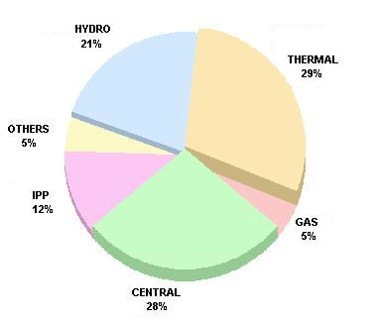
TN – Generation Installed Capacity
Installed capacity: 17,540 MW
10237 MW “firm” power (incl. IPPs & Central share)
7303 MW “infirm” power (wind, biomass, cogen)
Renewable Energy Capacity up to 31.03.2013
Wind Power 7145.00
Bagasse Cogeneration 659.40
Biomass Power 177.40
Solar Power (SPV) 17.00
Total 7998.80
Supply: roughly 8,000 MW
Demand: roughly 12,000 MW
Shortage: roughly 4,000 MW
T&D losses: around 18%

Slide 8
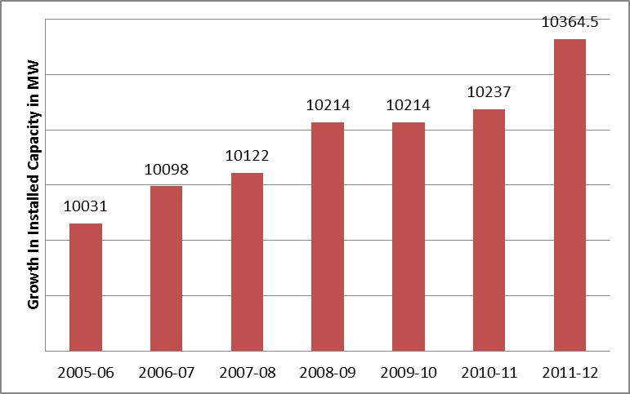
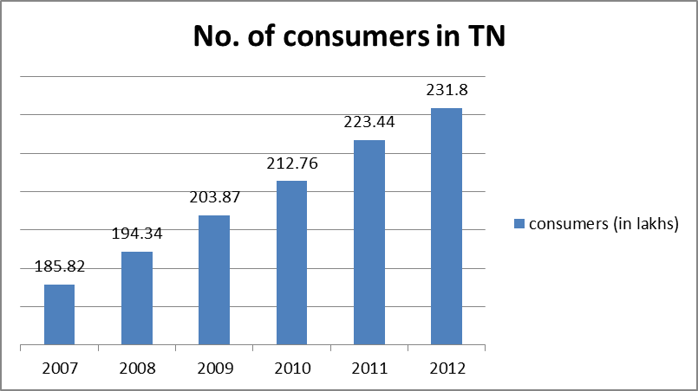
Widening demand supply gap
Limited capacity addition, despite several MoU’s and competitive bidding processes
266.5 MW added in 6 years; while 45,58,000 consumers were added during the same period
Source: Data Hand book www.tangedco.gov.in

Slide 9
Capacity addition: proposed vs. actual
 | 2007-08 | 2008-09 | 2009-10 | 2010-11 | 2011-12
Installed capacity (MW) | 10122 | 10214 | 10214 | 10237 | 10364.5
Demand (MW) | 8969 | 9459 | 10,046 | 11,500 | 12,000
Proposed capacity addition (MW) | 731 | 1025 | 1157 | 1459 | 4,640
Delivered capacity addition (MW) | 24 | 92 | 0 | 40 | 127.5
Source: Energy Policy Note, TNEB

Slide 10
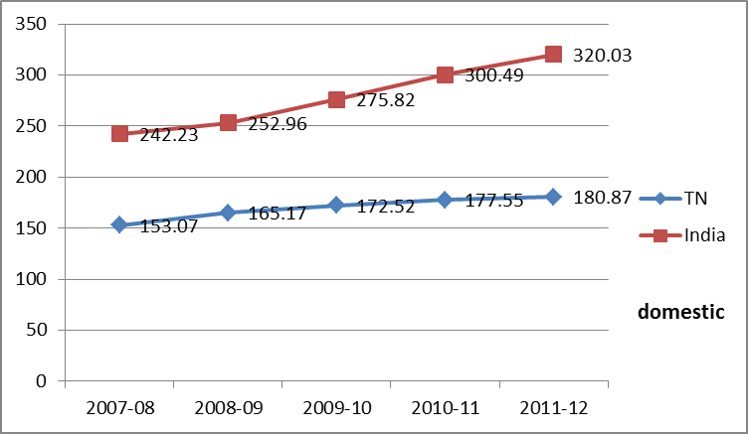
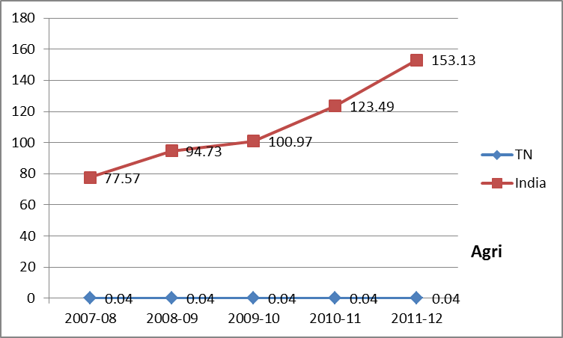
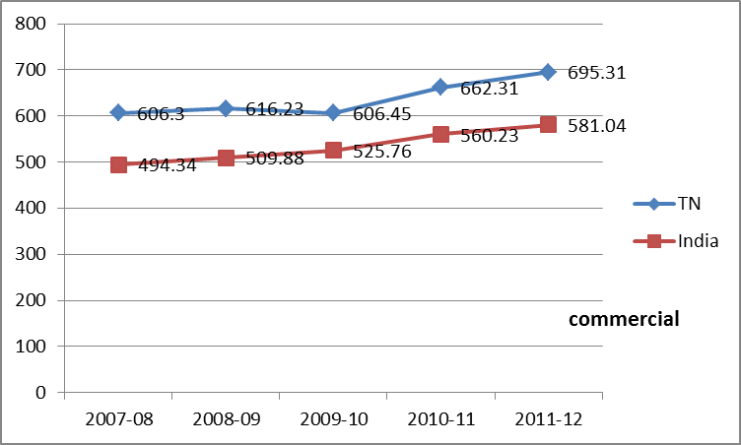
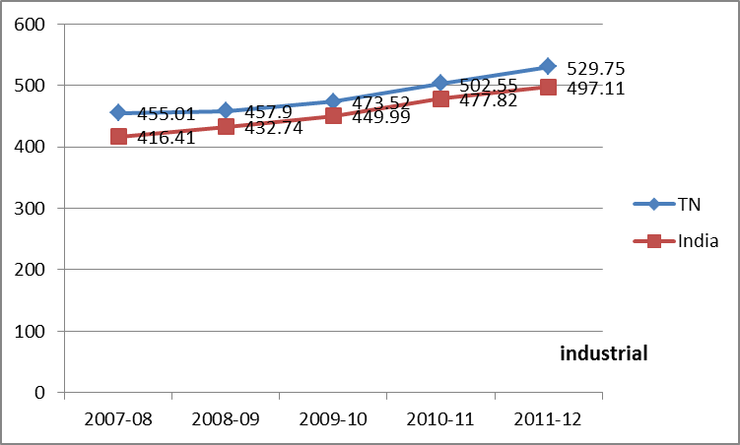
Tariffs: Tamil Nadu vs. India (paisa/KwH)
Source: Planning Commission reports

Slide 11
TN Consumption Data Source- 2011 Athena Infonomics

Slide 12
Tamil Nadu – high price paid for electricity
Chennai – Grid/DG usage
Madurai – Grid/DG usage
Chennai – electricity cost (Rs/kWh)
Madurai – electricity cost (Rs/kWh)
Heavy reliance on DG set due to
Power outages
Peak hour restrictions and
Maximum demand restrictions
Electricity cost based on
Diesel cost
DG set O&M & AMC cost
Cost of electricity from grid
Source: New Ventures India Surveys – sample space of offices (O), educational institutes (E), hotels (H), hospitals (M) and retail malls (R)

Slide 13
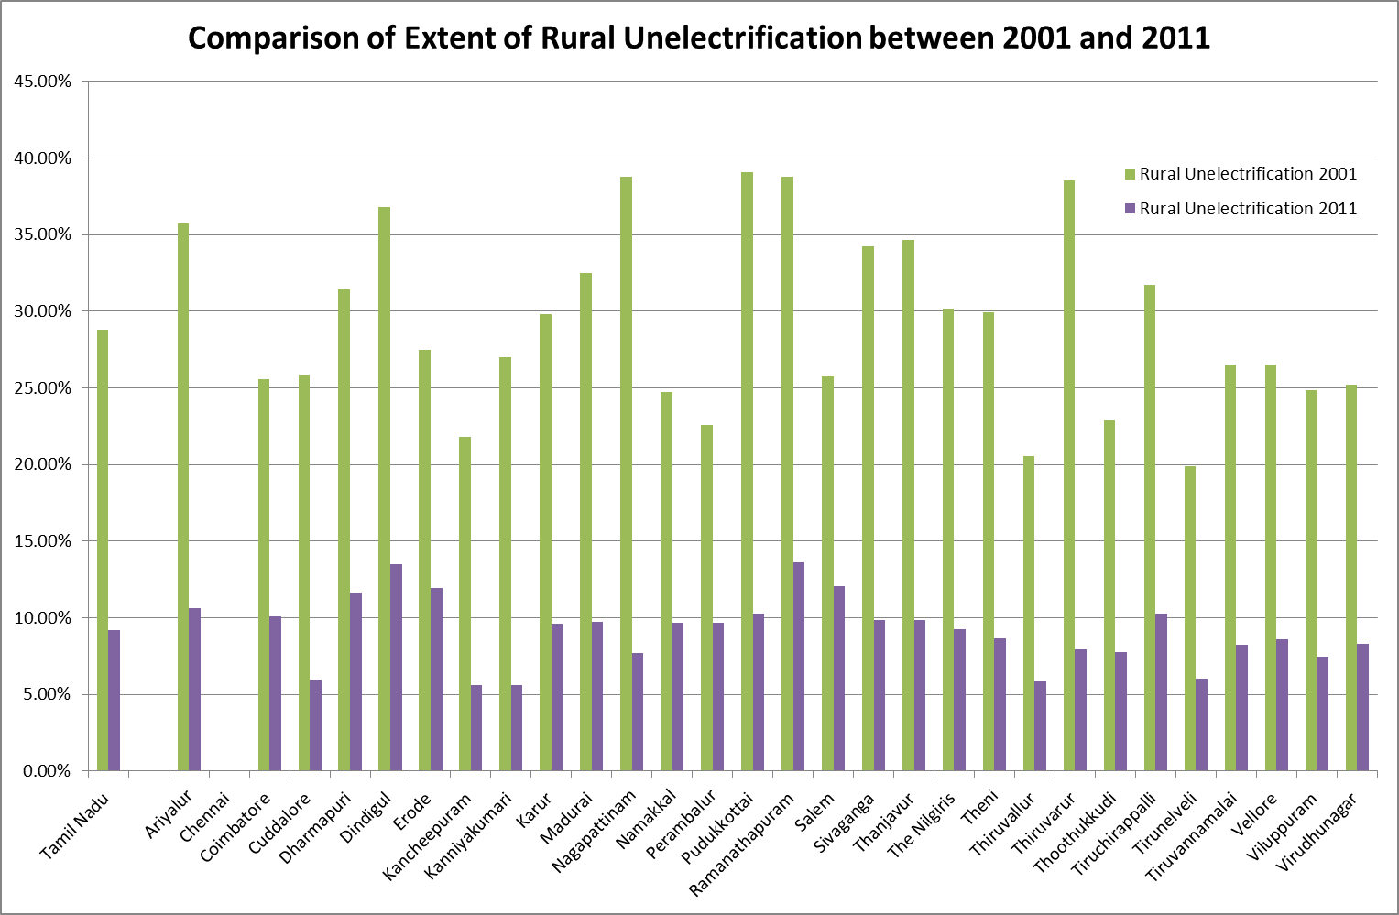
100% Electrification in TN?
Source: New Ventures India draft study based on Census data

Slide 16
Demand Analysis / Forecast
Per CEA 2013-2014 lGBR report Tn will have 4th highest deficit of 26.5 % with its energy requirement of 99765 MU and 3rd highest Peak deficit of 34.1 % with a 14,971 MW peak load requirement
Conflicting methodologies – use of CAGR
No clearly defined and publicly available data, assumptions, and calibration methodologies
Short term, medium term and long term projections are missing
No publicly available documents for comments and scrutiny.

Slide 17
Demand Analysis /Forecast
Limitations to estimating demand include …..
non-metering of agricultural loads
Restricted/Constrained load due to R&C measures and load shedding
local/circle wide demand information unavailable
Inadequate monitoring equipment
Communication between center -CEA and state agencies not streamlined
Inadequate resources assigned for demand analysis/forecasting
Does not account for unconnected demand (off-grid loads, unelectrified rural areas) , captive generation loads ,

Slide 18
SuppIy Options -Integrating RE, EE and Conventional energy
Detailed studies on potential of avoided capacity in TN with:
PAT and RAPDRP programs
Building sector efficiency
Other DSM programs - EE appliances, SWH, EE street lighting
R&M of power plants to improve efficiency
EE measures in the SME sector.
Studies on cost savings in implementing DSR programs to shift load peaks.
Implementing ‘Time of Use’ metering to balance costs of purchase with tariffs

Slide 19
Dispatch of energy resources

Slide 20
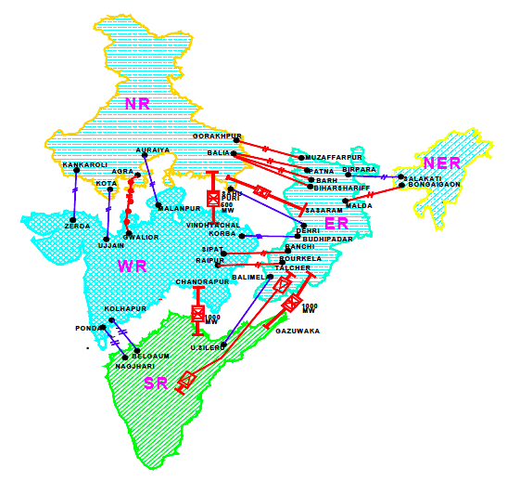
Transmission Bottlenecks
Interstate –Asynchronous link – high congestion charges – high elec costs New link between Solapur and Raichur I Intrastate - lack of wind evacuation
infrastructure – idle wind farms –stranded
generation
Source: CEA - Draft National Electricity Plan (Volume II) – Transmission, Feb- 2012. WR-SR reduction in Bursur-L, Sileru HVDC monopole as per Working Group on Power for 12th Plan, Jan 2012
Source: Transmission and Distribution in India – PGCIL report (2009 data)

Slide 21
TN Electricity Sector - Challenges
Proposed capacity addition 3000MW solar by 2017, vision 2023 envisions 20,000 capacity addition of thermal power. Makes sense?, Realistic?
Financial health – Rs 40,000 cr losses – will FRP help long term?
Bridging the ACS – ARR gap
Transmission bottlenecks
Unmetered Agricultural loads
Impact on welfare, business, livelihood, etc.
Chennai vs. rest of the State; urban TN vs. rural
Fragmented approach: Renewables and EE treated separately;
Civil society capacity / participation – limited
Source: TANGEDCO petition to TNERC, 2011

Slide 22
Why do we need to be concerned about TN’s electricity scenario ??
Unconnected consumers
&
Unreliable electricity for connected consumers
‘Business-as-usual’ top-down governance; Financial bankrupt utility
Ad hoc capacity addition decision; EE & RE not integrated into electricity planning
Widening gap between demand and supply of electricity
Limited transparency and accountability;
civil society capacity and participation weak

Slide 23
Paradigm Shift in thinking ?? source – ILSR (www.ilsr.org)

